Slide 1
ADVANCED PROGRAMING PRACTICES
SOEN 6441 - Advanced Programming Practices
Refactoring
Joey Paquet, 2006-2014

Slide 2
Refactoring: what is it?
SOEN 6441 - Advanced Programming Practices
Definition: Refactoring is a disciplined technique for restructuring an existing body of code, altering its internal structure without changing its external behavior.
Refactoring does not fix bugs, but it may help find bugs by scrutinizing code. It may also reduce the further introduction of bugs by cleaning-up code.
Refactoring does not add new functionality to the system, but it will ease the further adding of new functionality.
It is an essential part of agile software development such as Extreme Programming or incremental development.
Joey Paquet, 2006-2014

Slide 3
Refactoring: when?
SOEN 6441 - Advanced Programming Practices
Refactoring ought to be done continuously as “bad smells” are encountered during programming.
“Bad smells” or “anti-patterns” are portions of design or code that are characterized as potentially confusing and identifies as refactoring targets.
More importantly, when using iterative development, a major refactoring stage should precede the beginning of the development of a new build. This will remove slight design problems and ease the addition of further functionality.
In this case, refactoring counterbalances the productivity-driven software development practices implied by agile incremental software development.
Joey Paquet, 2006-2014

Slide 4
Refactoring: why?
SOEN 6441 - Advanced Programming Practices
Refactoring is usually done to:
  Improve quality
    improve design quality
    improve maintainability
    improve extensibility
    Improve sustainability of development
    requires proper testing, so improves testability
    helps to find bugs
  Improve productivity
    improve code readability & comprehensibility
    simplify code structure
Joey Paquet, 2006-2014

Slide 5
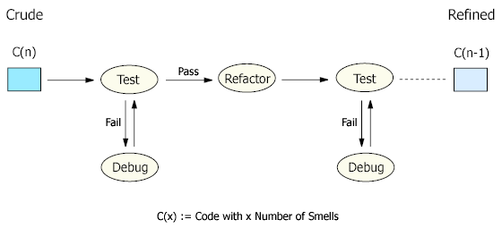
Refactoring: how?
SOEN 6441 - Advanced Programming Practices
Each refactoring is implemented as a small behavior-preserving transformation.
Behavior-preservation is achieved through pre- and post-transformation testing.
Refactoring process: test-refactor-test
Joey Paquet, 2006-2014

Slide 6
Refactoring: drawbacks
SOEN 6441 - Advanced Programming Practices
Cost Overhead: Refactoring is an add-on activity and therefore will incur extra cost in form of time, effort, and resource allocation, especially if elaborated design and code documentation is maintained. However, when done sparingly and only on key issues, its benefits are greater than its overhead. Automated documentation tools, code browsing tools, refactoring tools and testing tools will also diminish the refactoring overhead.
Requires Expertise: Refactoring requires some expertise and experience and considerable effort in going through the process, especially if proper testing is involved. However, this overhead can be minimized by using refactoring tools and automated testing such as with a unit testing framework.
Joey Paquet, 2006-2014

Slide 7
SOEN 6441 - Advanced Programming Practices
Refactoring patterns
Joey Paquet, 2006-2014

Slide 8


Reractoring: examples
SOEN 6441 - Advanced Programming Practices
Encapsulate Downcast: A method returns an object that needs to be downcasted by its callers. Refactor by moving the downcast to within the method.
Object lastReading() {
return readings.lastElement();
}
Reading lastReading() {
return (Reading) readings.lastElement();
}
Joey Paquet, 2006-2014

Slide 9


Refactoring: examples
SOEN 6441 - Advanced Programming Practices
Consolidate Conditional Expression: You have a sequence of conditional tests with the same result. Refactor by combining them into a single conditional expression and extract it.
double disabilityAmount() {
if (_seniority < 2) return 0;
if (_monthsDisabled > 12) return 0;
if (_isPartTime) return 0;
// compute the disability amount
double disabilityAmount() {
if (isNotEligibleForDisability()) return 0;
// compute the disability amount
Joey Paquet, 2006-2014

Slide 10


Refactoring: examples
SOEN 6441 - Advanced Programming Practices
Consolidate Duplicate Conditional Fragments: The same fragment of code is in all branches of a conditional expression. Refactor by moving it outside of the expression.
if (isSpecialDeal()) {
total = price * 0.95;
send();
} else {
total = price * 0.98;
send();
}
if (isSpecialDeal())
total = price * 0.95;
else
total = price * 0.98;
send();
Joey Paquet, 2006-2014

Slide 11


Refactoring: examples
SOEN 6441 - Advanced Programming Practices
Rename Method: The name of a method does not reveal its purpose. Refactor it by changing the name of the method.
int getInvCdtLmt(){
…
}
int getInvoiceableCreditLimit(){
…
}
Joey Paquet, 2006-2014

Slide 12
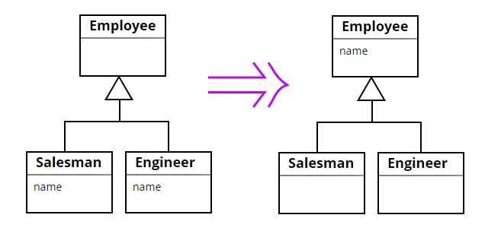
Refactoring: examples
SOEN 6441 - Advanced Programming Practices
Pull Up Field: Two subclasses have the same field. Refactor it by moving the field to the superclass.
Joey Paquet, 2006-2014

Slide 13
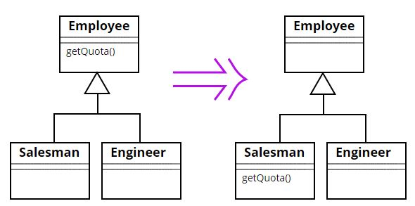
Refactoring: examples
SOEN 6441 - Advanced Programming Practices
Push Down Method: Behavior on a superclass is relevant only for some of its subclasses. Refactor it by moving it to those subclasses.
Joey Paquet, 2006-2014

Slide 14
Refactoring: practice
SOEN 6441 - Advanced Programming Practices
Some refactorings are controversial.
Some refactorings are arguably not improving code quality.
Some refactorings can in fact be counter-productive when applied blindly, especially in iterative development, where design is evolving.
Have your team adopt a set of refactorings to be applied, and make sure that refactorings are applied in a productive manner.
Apply in combination with the application of design patterns.
Use refactoring tools to automate changes, e.g. Eclipse refactoring, and JUnit testing framework.
Joey Paquet, 2006-2014

Slide 15
References
SOEN 6441 - Advanced Programming Practices
Source Making. Refactoring. http://sourcemaking.com/refactoring
Martin Fowler, Kent Beck, John Brant, William Opdyke, Don Roberts. Refactoring: Improving the Design of Existing Code. Addison-Wesley Professional, 1999. ISBN-13: 978-0201485677.
Martin Fowler. Refactoring.com.
Joey Paquet, 2006-2014

